Slide 1
COMP 315 Camera, projection and model view
Deshen Moodley
University of KwaZulu-Natal

Slide 2
Coordinate Systems
The units in points are determined by the application and are called object, world, model or problem coordinates
Viewing specifications usually are also in object coordinates
Eventually pixels will be produced in window coordinates
OpenGL also uses some internal representations that usually are not visible to the application but are important in the shaders

Slide 3
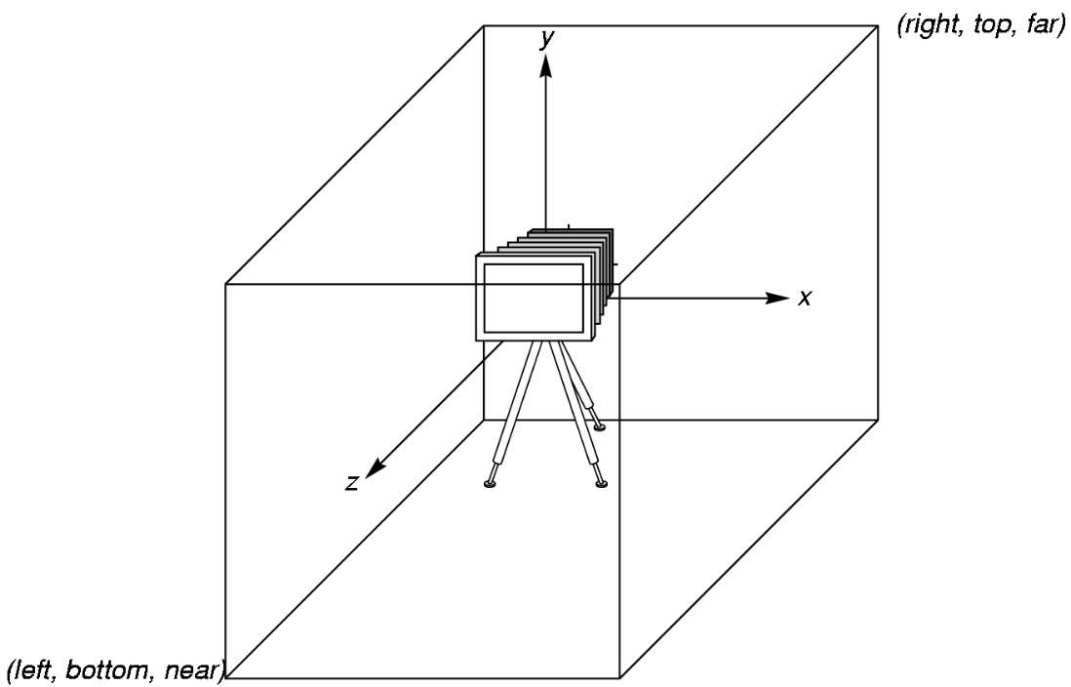
OpenGL Camera
OpenGL places a camera at the origin in object space pointing in the negative z direction
The default viewing volume
is a box centered at the
origin with sides of
length 2, i.e. x, y & z values range
from -1 to 1

Slide 4
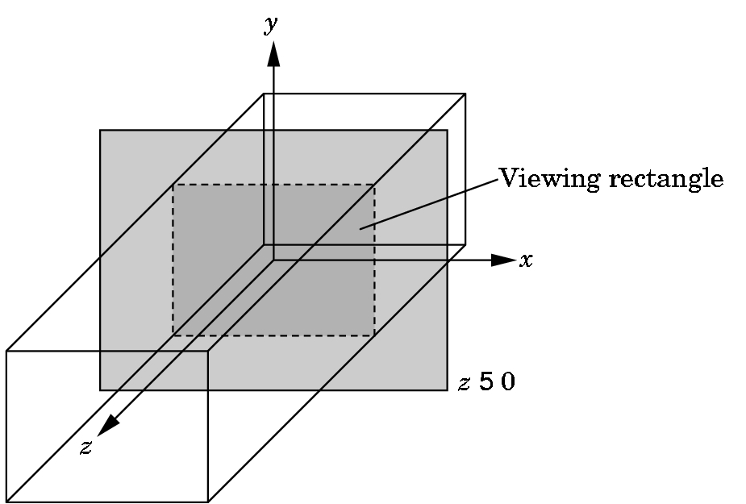
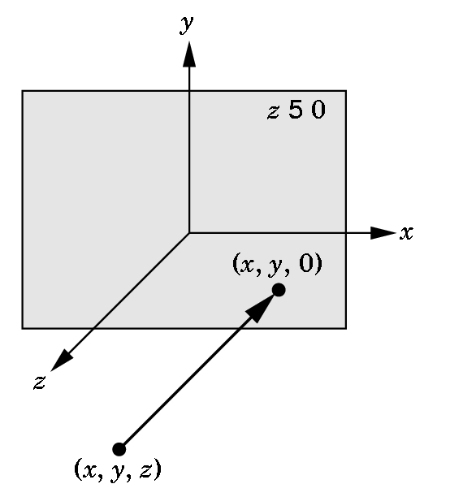
Orthographic Viewing
In the default orthographic view, points are
projected forward along the z axis onto the
plane z=0
z=0
z=0

Slide 5
Transformations and Viewing
The graphics system automatically transforms World (object) coordinates to screen coordinates
In OpenGL, projection is carried out by a projection matrix (transformation)
Transformation functions are also used for changes in coordinate systems
Pre 3.0 OpenGL had a set of
transformation functions
which have been deprecated
Will look at these later

Slide 6
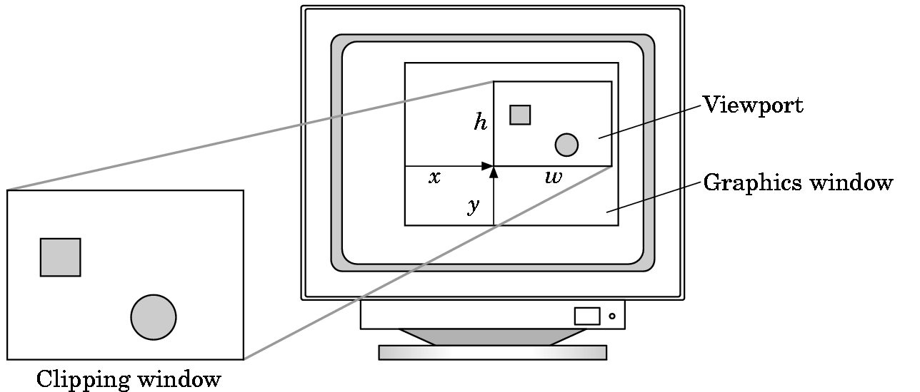
Viewports
Do not have use the entire window for the image: glViewport(x,y,w,h)
Values in pixels (window coordinates)

Slide 7
Geometric primitives – outline shapes
Points, lines & triangles are basic
Other’s like quads, polygons are approximated using the basic primitives
Outline shapes:

Slide 8
Geometric primitives – filled shapes
Polygon mode is used to create filled shapes
To generate a edge and the fill requires two renderings

Slide 9
Geometric primitives – filled shapes
Polygon mode is used to create filled shapes
To generate a edge and the fill requires two renderings

Slide 10
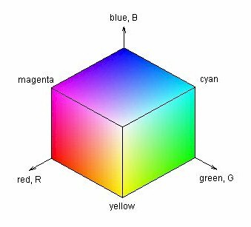
Colour
Uses RGB colour space
Is independent of display adapter/display device
Specify a point on a unit RGB colour cube
Float values along each side axis range from 0 – 1 -> (r, g, b)
Examples
1, 1, 1 -> white
1, 0, 0 -> red
0, 1, 0 -> green,
yellow ?
To set the current colour use gl.glColor3f(r, g, b)

Slide 11
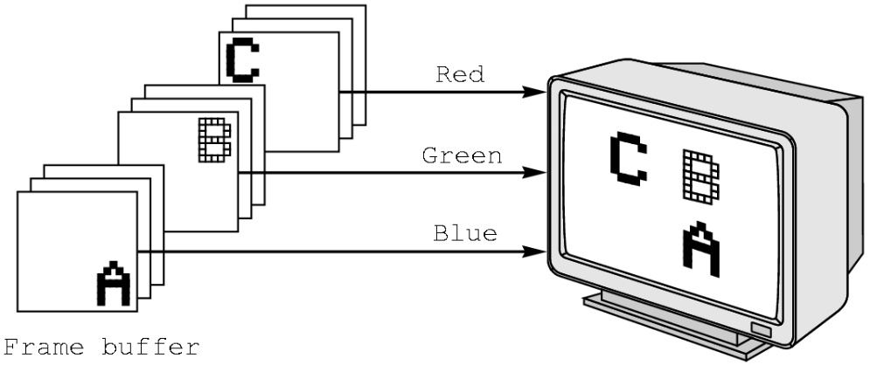
RGB color
Each color component is stored separately in the frame buffer
Usually 8 bits per component in buffer
Color values can range from 0.0 (none) to 1.0 (all) using floats or over the range from 0 to 255 using unsigned bytels

Slide 12
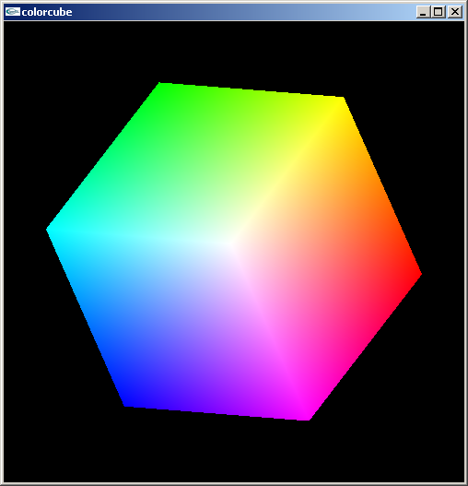
Smooth Color
Default is smooth shading
OpenGL interpolates vertex colors across visible polygons
Alternative is flat shading
Color of first vertex
determines fill color
Handle in shader

Slide 13
Program Structure
Most OpenGL programs have a similar structure that consists of the following functions
main():
glutInit initializes GLUT
glutInitWindowSize, glutInitWindowPosition,glutCreateWindow Creates a window at the specified position and size
glutDisplayFunc, glutReshapeFunc sets the display and reshape call back functions
glutMainLoop Enters an infinite processing loop
initGL(): sets the state variables, viewing, attributes (called directly in main to group once off initial commands)
display()- OpenGL statements to render objects
reshape()- first repaint after component has been resized and when window first appears

Slide 14
Two dimension transformations
Three general transformations
Translation - moves the world along the x,y,z axis
Rotation - rotates the world around the x,y,z axis
Scaling - magnifies or shrinks the world
3D case is a simple extension of 2D method for translation and scaling but more complicated for rotation
OpenGL provides the following function for 3D transformations
Translation - glTranslate(x,y,z)
Scaling - glScale(x,y,z)
Rotation - glRotate(angle, x, y, z)
See Nate Robbins Transformation tutor program

Slide 15
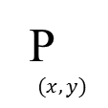
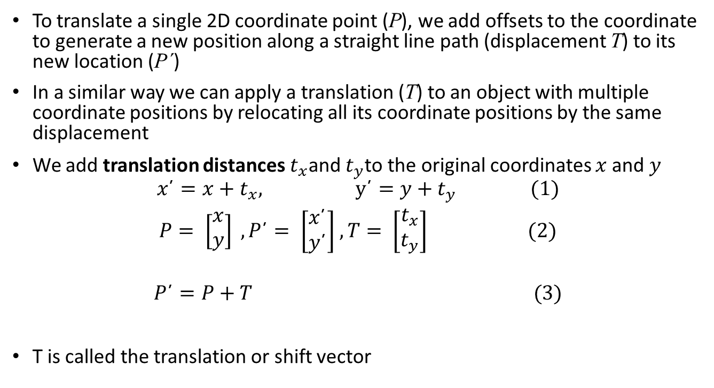

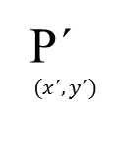
Translation -2D
T$(t_{x},t_{y})$
P´
$$(x\text{´},y\text{´})$$
To translate a single 2D coordinate point (P), we add offsets to the coordinate to generate a new position along a straight line path (displacement T) to its new location (P´)
In a similar way we can apply a translation (T) to an object with multiple coordinate positions by relocating all its coordinate positions by the same displacement
We add translation distances $t_{x}$and $t_{y}$to the original coordinates $x$and $y$
$$x\text{´}=x+t_{x}, \text{y}\text{´}=y+t_{y} (1)$$
$P= \left[\begin{matrix}x \\ y\end{matrix}\right] ,P\text{´}= \left[\begin{matrix}x\text{´} \\ y\text{´}\end{matrix}\right]$ $, T= \left[\begin{matrix}t_{x} \\ t_{y}\end{matrix}\right] (2)$
$$P\text{´}=P+T (3)$$
T is called the translation or shift vector
P
$$(x,y)$$

Slide 16
Translate example
glMatrixMode(GL_MODELVIEW); // To operate on Model-View matrix
glLoadIdentity(); // Reset the model-view matrix
glTranslatef(-0.5f, 0.4f, 0.0f); // Translate (x,y,z) left and up
glBegin(GL_QUADS); // Each set of 4 vertices form a quad
glColor3f(1.0f, 0.0f, 0.0f); // Red
glVertex2f(-0.3f, -0.3f); // Define vertices in counter-clockwise // (CCW) order
glVertex2f( 0.3f, -0.3f); // so that the normal (front-face) is // facing you
glVertex2f( 0.3f, 0.3f);
glVertex2f(-0.3f, 0.3f);
glEnd();

Slide 17
Rotation example
glRotatef(180.0f, 0.0f, 0.0f, 1.0f); // Rotate 180 degrees around the x
// axis
glBegin(GL_TRIANGLES); // Each set of 3 vertices form a triangle
glColor3f(1.0f, 0.0f, 0.0f); // Red
glVertex2f(-0.3f, -0.2f);
glColor3f(0.0f, 1.0f, 0.0f); // Green
glVertex2f( 0.3f, -0.2f);
glColor3f(0.0f, 0.0f, 1.0f); // Blue
glVertex2f( 0.0f, 0.3f);
glEnd();

Slide 18
Transformation example
Work through GL04ModelTransform.cpp program in the tutorial to gain an understanding of transformations on the world
Check Howard’s OpenGL Tutorial and Reference, page 49 to gain a better understanding of the OpenGL transformation commands

Slide 19
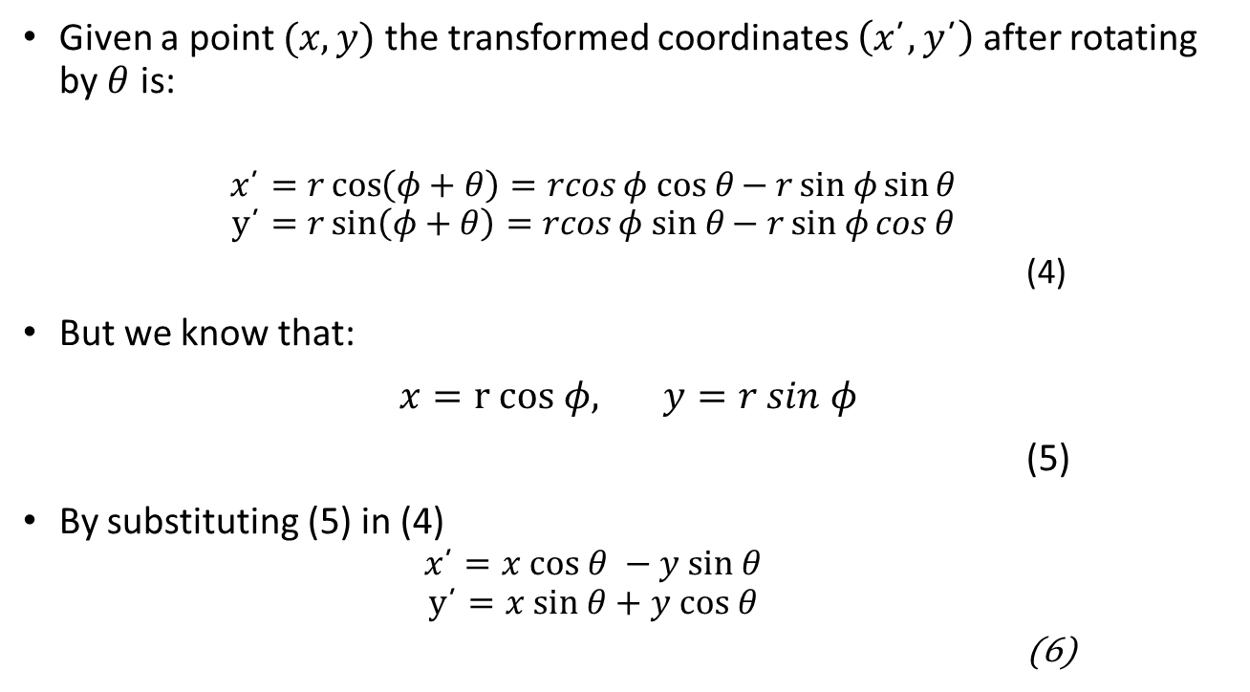





Rotation
$$y$$
Given a point $(x,y)$ the transformed coordinates $\left(x\text{´},y\text{´}\right)$ after rotating by $θ$ is:
$$x\text{´}=r\cos\left(φ+θ\right)=rcosφ cos θ{− rsin φ{\sin{θ}}}$$
$$y\text{´}=r\sin\left(φ+θ\right)=rcosφ sin θ{− rsin φ{\cos{θ}}}$$
(4)
But we know that:
$x=r cos φ, y=r sin φ$
(5)
By substituting (5) in (4)
$$x\text{´}=x cos θ −y sin θ$$
$$y\text{´}=x sin θ+y cos θ$$
(6)
$$(x\text{´},y\text{´})$$
θ
$$(x,y)$$
$$φ$$
$$x$$

Slide 20
OpenGL tutorial
You should work your way through the following tutorials to familiarise yourself with OpenGL in C++
https://www3.ntu.edu.sg/home/ehchua/programming/opengl/CG_Introduction.html
Toby Howard's tutorial and reference guide on the course website

